Slide 1


Climate change
affecting St. Louis
Hackers:
Sincere Ponton
Iasia Cooper
Antonio Vallez
Tony Guy
Mentors:
Dr. Malcolm Dcosta
Dr. Mohammed Elbakary
John Holly

Slide 2
Our mission
We want you to join the Cool Ducks team in battling the current environmental crises we all know as climate change by providing you with data on temperature changes in St. Louis in hopes of inspiring healthier environmental habits.

Slide 3
What is Climate Change?
Climate Change refers to the overall changes in temperatures and other conditions throughout the years. These changes can occur naturally, but recently human activities have been the main driver for climate change due to the excessive burning of fossil fuels.

Slide 4
How does climate change affect us?
Climate change affects us by:
Rise in temperatures
Increase in weather anomalies
Polar Ice caps melting

Slide 5
Possible outcomes of climate change
Decrease in crop production
Scarcity in consumer goods
In-fighting due to limited resources
Full-scale war

Slide 6
Our Project
We tackled the task of proving that climate change is affecting the area of St. Louis, Missouri. To go about this, we searched the web for data concerning annual average air temperatures in St. Louis and how they change over time.
We wanted to:
Model this behavior using graphs
Show visually how climate change is impacting St. Louis

Slide 7
What We Used
In order to gather our findings we used a range of technologies, like Jupyter Notebook and Google Cloud.. In Jupyter notebook, we tested various functions to ensure that our code worked. Those functions include getting the latest version of a .PDF file from a URL, gathering data from said .PDF file, organizing the received data into a proper JSON format, visualizing said data into actual graphs, and much more. Once we finished successfully testing our code, we moved everything to a Flask designed website using the Google Cloud provide for us.
Check out our website!

Slide 8

Our Website
Check out our website!

Slide 9
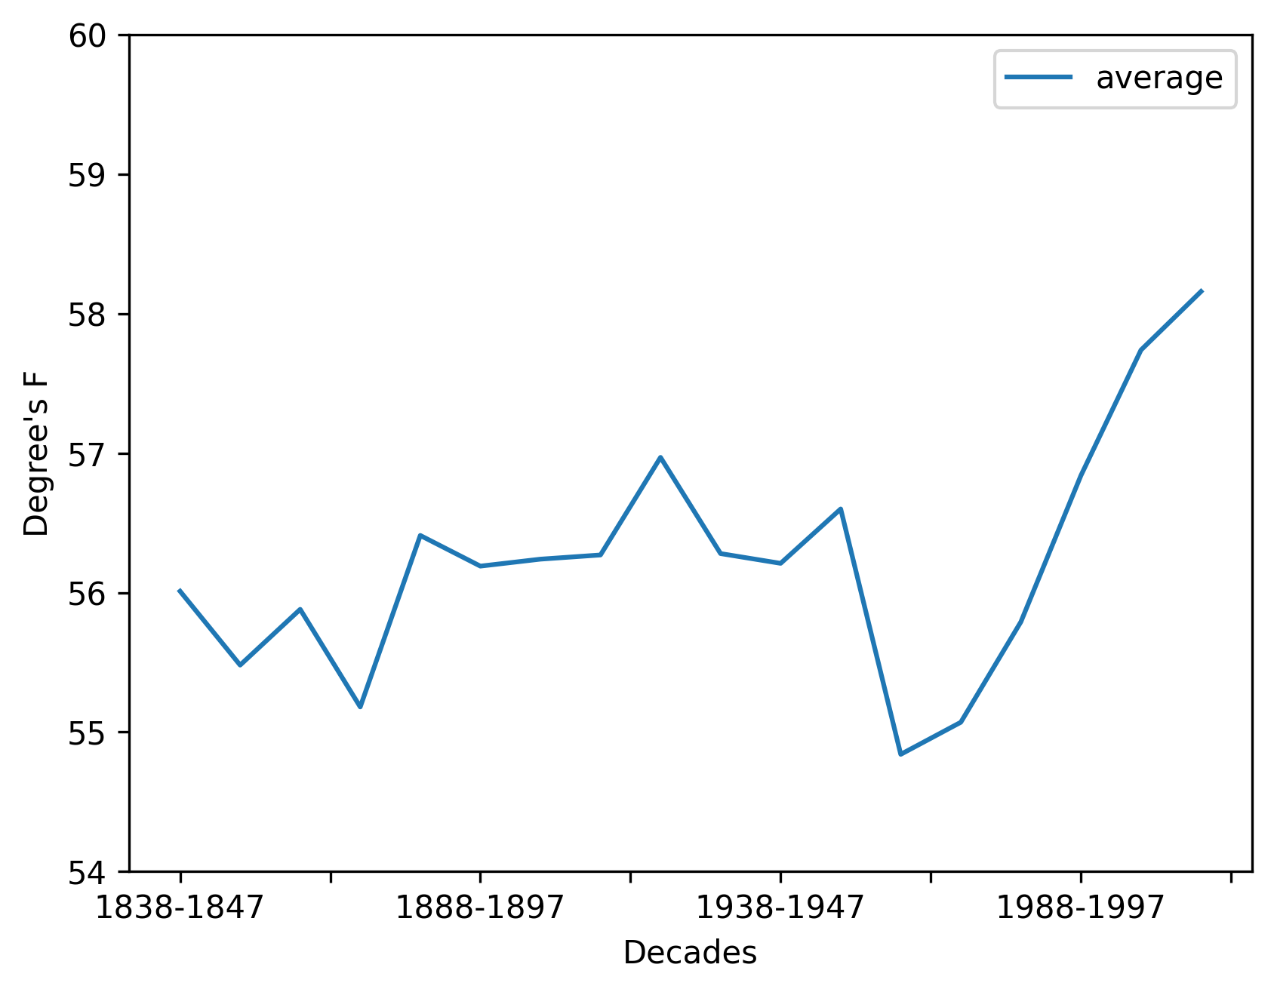
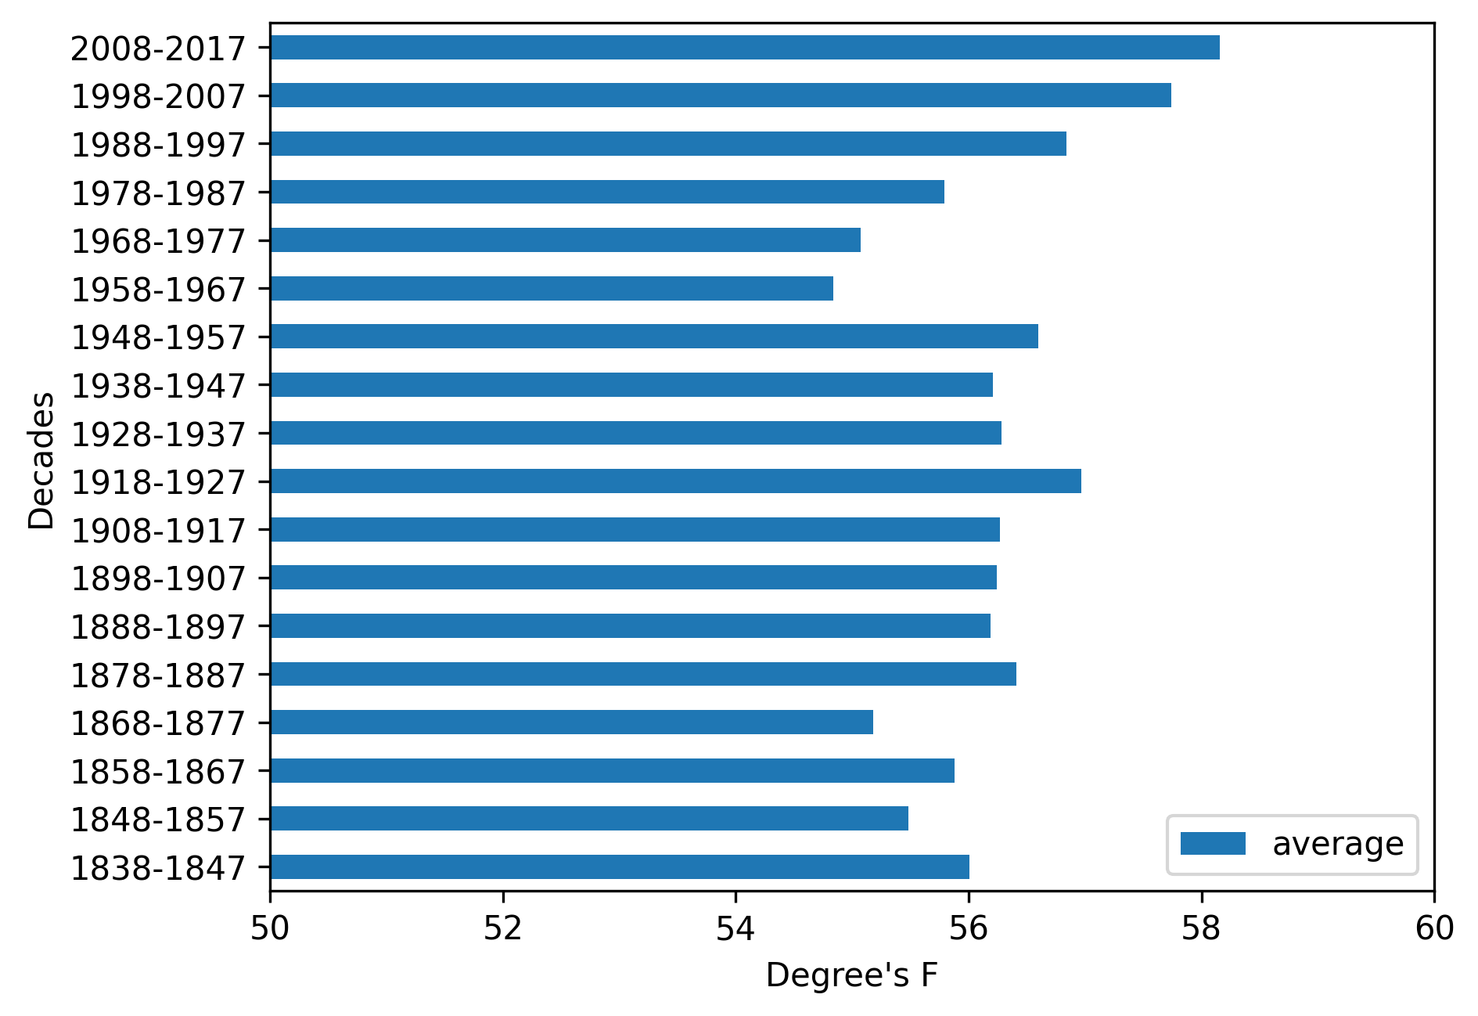
Our Findings
Our findings indicated an increase of temperatures within the last few decades. This increase proves that climate change is not only effecting St. Louis but the entire world. We use tabula-py to convert the data from the pdf then we converted the data to graphs using the matplotlib python module.

Slide 10
Our Conclusion
Based on our findings, we can conclude that the average temperatures are currently at an all-time high compare to the earlier years in St Louis. This increase in temperatures shows a distinct trend towards a warmer climate. This could be an explanation for the increase in inclimate weather in St. Louis. Warmer temperatures increase weather anomalies.

Slide 11
Citations
"Call to Action" Global Climate and Health Forum,
https://www.globalclimateandhealthforum.org/call-to-action#:~:text=A%20Call%20to%20Action%20on,depend%20on%20for%20our%20survival
“Overview: Weather, Global Warming and Climate Change.”
Nasa NASA, 24 Aug. 2021, https://climate.nasa.gov/resources/global-warming-vs-climate-change/
TEMP STL Annual Averages.xls 1/5/2021 https://www.weather.gov/media/lsx/climate/stl/temp/temp_stl_annual_averages.pdf

